Slide 1
Advancing Research:
Translational Research and Information Lab (TRAIL)
Tania Bardyn, MLIS, AHIP
Associate Dean of UW Libraries
Director of UW Health Sciences Library
Emily Patridge, MLS, AHIP
Assistant Director of Clinical Research and Data Services
Notes:
Tania
One of four lighting talks for the Provost Walking Tour

Slide 2
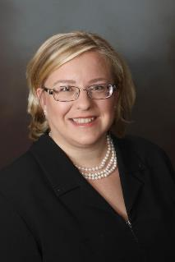
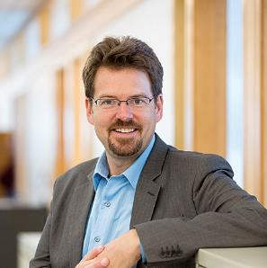
Partnering with Institutional Stakeholders: Executive Leadership
Sean D. Mooney, PhD
Chief Research Information Officer,
UW Medicine
Professor, Department of Biomedical
Informatics & Medical Education
Tania Bardyn, MLIS, AHIP
Associate Dean of University Libraries
Director of the Health Sciences Library
Director, NN/LM PNR
Notes:
Tania

Slide 3
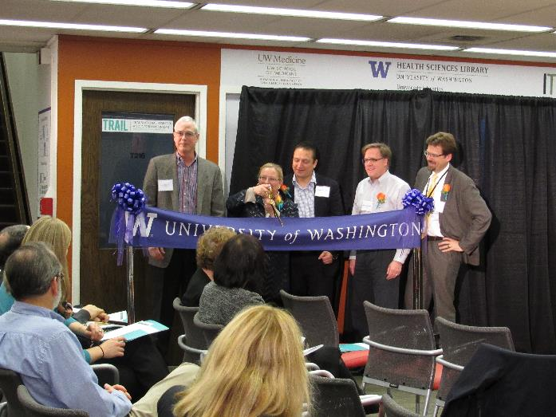
VISION:
TRAIL is a collaboration accelerating healthcare research through services, space, and tools through five UW campus partners.
TRAIL Ribbon Cutting Ceremony
November 7, 2016, Seattle, WA Health Sciences Library
Notes:
Emily
Kicked off with a trail ribbon cutting ceremony and have progressed to year 3

Slide 4
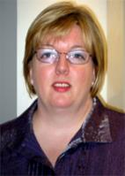
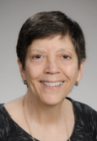
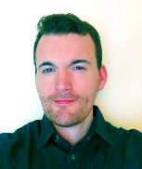
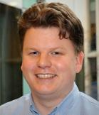
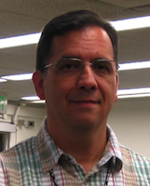
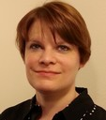
TRAIL Staff
Jane Koh
Andrea Ball, MLS, MSIM
Partner Affiliation:
HSL
PNR
UW IT RIT
ITHS
UW BIME
Ann Madhavan, MSLIS
Ashleigh Lewis
Michael Moore, MISt
Bas de Veer MS
Adam Garrett
Derich Ruhl
Emily Patridge, MLS, AHIP
Notes:
Show the wide variety of location

Slide 5
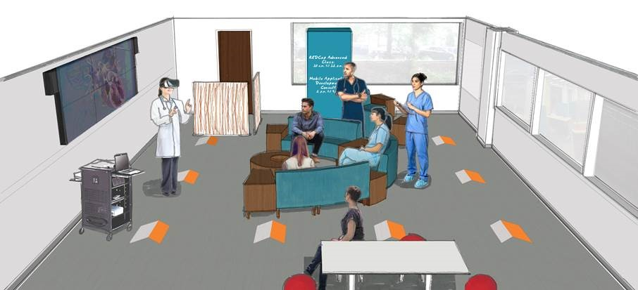
Space
Notes:
Emily

Slide 6
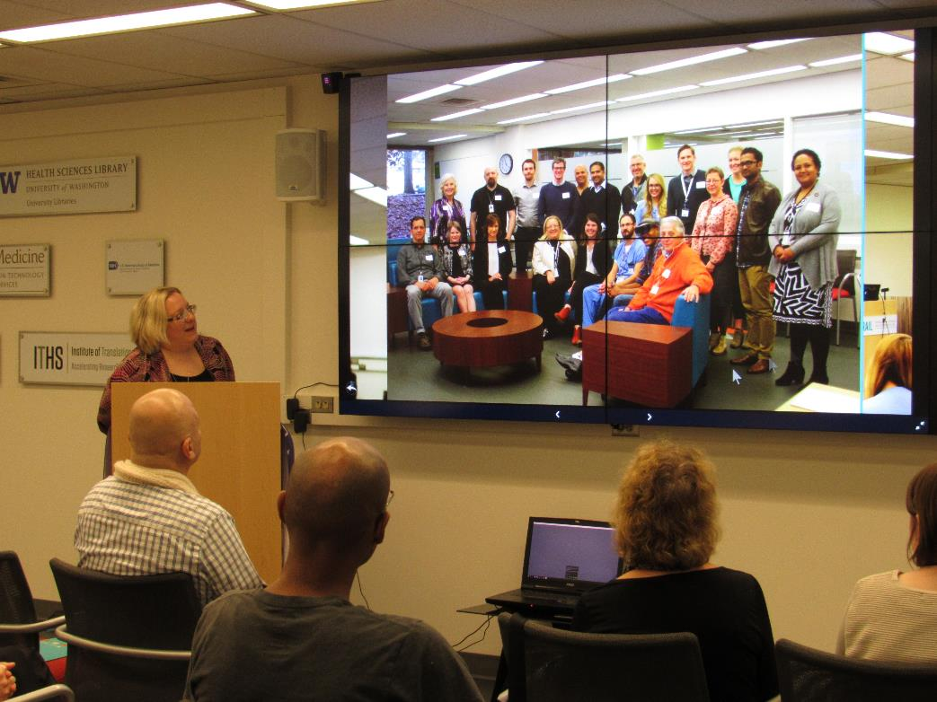
Space

Slide 7
Use of Space
Notes:
Emily
We have clinicians come out to the space to prepare for surgery by demo-ing a 3D heart
https://hsl.uw.edu/trail/media/

Slide 8
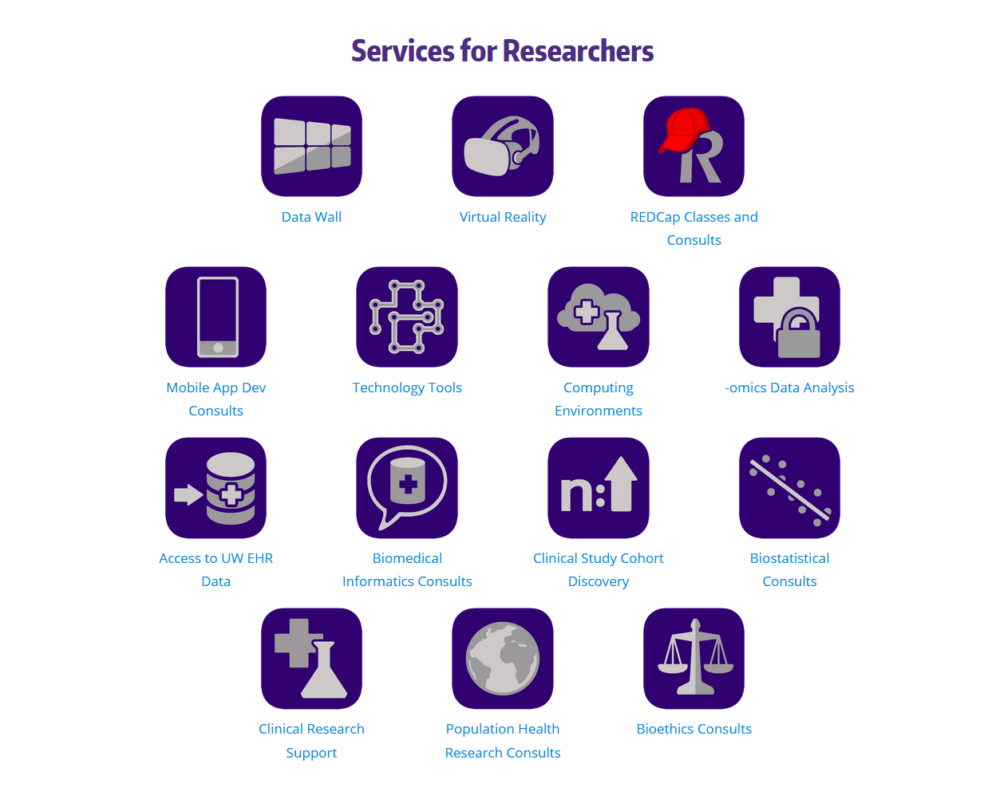
Services
Notes:
Bas
Impacts the community

Slide 9
Tools - REDCap
Research Electronic Data Capture
Hosted by the Institute of Translational Health Sciences
Current users: 9.000+
Current projects: 15.000+
Survey responses: 1.000.000+
10th largest installation worldwide (out of 3250+)
TRAIL & REDCap - 2018
Tickets handled a year: 8731
Weekly training sessions in Trail: 43
Number of people trained in 2018: 277

Slide 10
Real Life Example – SCOUTS Study
Neurologist at HMC
Looking at CPAP effects in stroke patients
No funding initially for pilot
Doing data entry in excel
Switch to REDCap
Allowed for 35 participants to be captured
Allowed him to capture enough solid data to apply for a grant
End result: Got awarded the grant for follow-up study
Refined study to include 90 participants

Slide 11
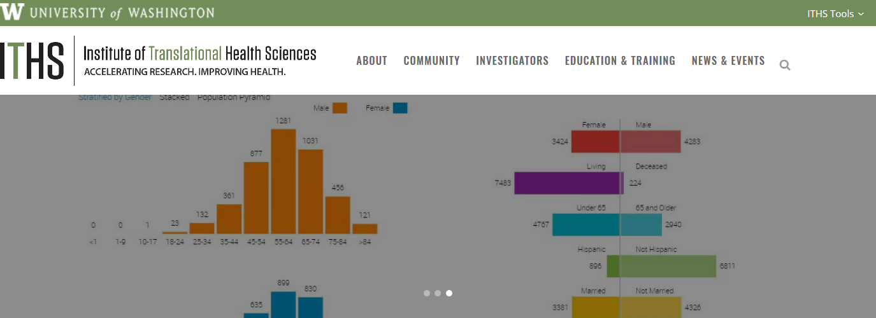
Upcoming Tool - Leaf
Notes:
Leaf is a self-service tool which provides UW investigators with a user friendly interface for querying the electronic health system records within UW Medicine. Unlike other cohort discovery tools, Leaf interacts directly with live data from the electronic health system and can generate reports in real time. Electronic health system data can help investigators answer a variety of questions about patient populations including medical and demographic information, clinical processes, and department statistics.

Slide 12
Selected TRAIL Bibliography
Bardyn T, Mooney S, Patridge E, Ruhl D. Information Resources/Translational Research/Library convergence: The newly emerging collaboration lab model called the Translational Research and Information Lab (TRAIL). Paper presented at: Association of Academic Medical Colleges (AAMC) 2017 Group on Business Affairs/Group on Institutional Planning (GBA/GIP) / Group on Information Resources (GIR) Joint Spring Meeting; May 10, 2017; Atlanta, GA. http://www.cvent.com/events/2017-group-on-business-affairs-group-on-institutional-planning-and-group-on-information-resources-jo/agenda-3b6cf2f32ee441c39c915e1ca2bd8efe.aspx. Accessed January 18, 2018.
Bardyn, T, Patridge E, Moore M, Koh J. "Health Sciences Libraries Advancing Collaborative Clinical Research Data Management in Universities." Journal of eScience Librarianship 7(2): e1130. https://doi.org/10.7191/jeslib.2018.1130. Published July 2018. Accessed August 17, 2018.
Bardyn T. This university’s interactive lab is revolutionizing research. eCampus News: Technology News & Innovative in Higher Education. https://www.ecampusnews.com/featured/featured-on-ecampus-news/university-of-washington-lab/. Published June 7, 2017. Accessed January 18, 2018.
Patridge E, Bardyn T. Translational Research and Information Lab (TRAIL): Paving the way to better coordinated population health and improved understanding of research data management at one academic health sciences campus. Paper presented at: Pacific Northwest Chapter of the Medical Library Association Annual Conference; October 17, 2016; Portland, OR. https://pnc-mla.wildapricot.org/page-1681922. Accessed January 18, 2018.
Patridge E, Bardyn T. Research Electronic Data Capture (REDCap). JMLA: Journal of the Medical Library Association. 2018; 106(1): 142-144. doi: 10.5195/jmla.2018.319.
Notes:
Emily
We are excited about third year and this is a highlight of presentations and publications we have done to promote TRAIL. One of our highlights is creating a Virtual Reality primer for other health sciences library.

